Slide 1
Camera Health Platform
Training programme | October 2026
Notes:
Welcome. Introduce yourself and the purpose: by the end of today everyone in the room can explain what the platform does (managers) or run the daily routine unaided (engineers). The deck has three modules; managers usually leave after module A.

Slide 2
Today's programme
Three modules: pick the ones for your role
A
30 min
B
2.5 h
C
1 h
WHY AND WHAT
USING THE PLATFORM
ADMINISTRATION
Management briefing
Engineers & supervisors
IT & administrators
• The problem with cameras on moving machinery
• How the platform works
• Value, readiness, rollout
• The daily routine
• Reading and verifying results
• Learning, reports, cameras, schedule
• Hands-on exercises + knowledge check
• Install, ports, power
• Backups, upgrades, retention
• Security checklist
• Troubleshooting
CAMERA HEALTH PLATFORM | TRAINING 2
Notes:
Module A is a 30-minute briefing for managers. Module B is the 2.5-hour hands-on session for verification engineers and supervisors. Module C is for IT. Hand out the Quick Reference Card at the start of Module B.

Slide 3
Module A
Why and what
Management briefing | 30 minutes
Notes:
Module A: keep it visual and short. Key message: automation for the repetitive part, people for judgement, and the system learns from those judgements.

Slide 4
The problem
Thousands of cameras, on machines that never stand still
01
02
03
04
MOVING VIEWS
HIDDEN FAULTS
MANUAL EFFORT
MIXED FLEET
Cameras on cranes, spreaders and trailers never show the same picture twice, so fixed-reference CCTV tools fail.
Dirty lenses, tints and partly covered lenses are found only when footage is needed after an incident.
Logging in, saving a screenshot, judging it and writing it up takes minutes per camera, every day.
Old 2K and new 4K cameras look different. One rule set floods engineers with false alarms.
CAMERA HEALTH PLATFORM | TRAINING 4
Notes:
Stress the moving-machinery point: standard CCTV health tools compare with a fixed reference picture; that does not work here. Then the manual effort, and the camera-generation problem that causes false alarms.

Slide 5
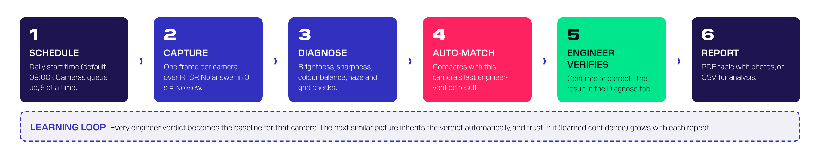
How it works
One picture per camera per day, diagnosed automatically, verified by people
Runs on one PC in the local network. No cloud, no internet at runtime, no new hardware at the cameras.
Detects 8 conditions: no view, too dark, overexposed, green / blue / red tint, dirty or blurry lens, partial occlusion.
Every decision is recorded with engineer name, time, remark and photo: a full audit trail.
CAMERA HEALTH PLATFORM | TRAINING 5
Notes:
Walk the six steps left to right. Point at the learning loop: every verdict becomes that camera's baseline; similar later pictures inherit it; worse ones come back to a person.

Slide 6
The value
Illustrative daily effort for 1,000 cameras
117 h
manual person-hours per daily round
4 h
with the platform: verification only
~30 min
to check ~3,600 cameras (default settings)
CAMERA HEALTH PLATFORM | TRAINING 6
Notes:
Figures use the platform's own default role estimates (editable in building_status.py): 3 min capture, 2 min review, 1.5 min report per camera, 5 min to verify a flagged camera; 10% flagged per day, half of them repeats that are auto-matched. Ask the site to replace these with real numbers.

Slide 7
Readiness and rollout
Functionally complete; six items to close before all-terminal rollout
1 PILOT
2 ROLLOUT
3 EMBED
KPIS TO TRACK
4 weeks
4-6 weeks
Ongoing
Fleet health % cameras OK
Backlog awaiting verification at day end = 0
Repair speed days from detection to OK
Automation auto-matched share
False alarms % Normal / false detection
Reliability runs completed on time
One terminal. Hardening done, engineers trained. Exit: run completes daily, backlog cleared daily.
All terminals imported; parallel capture tuned with the network team. Exit: fleet checked before 10:00.
Weekly KPI review, tickets linked in remarks, building dashboard, quarterly threshold review.
MUST CLOSE FIRST | PRIORITY
Confirm & freeze the production source version | High
Restrict access and add sign-in | High
Protect camera passwords (plain text today) | High
Production web server, auto-start, no-sleep | Medium
Backups and picture retention (~40-55 GB / 1,000 cameras / year) | Medium
CAMERA HEALTH PLATFORM | TRAINING 7
Notes:
Be candid: the code works end to end in the demo, but the project folder mixes file versions, there is no login, and passwords are stored in plain text. These are normal pilot-stage items. Then the three phases.

Slide 8
Module B
Using the platform
Verification engineers & supervisors | 2.5 hours
Notes:
Module B is hands-on. Everyone should have the dashboard open in a browser and the Quick Reference Card in front of them.

Slide 9
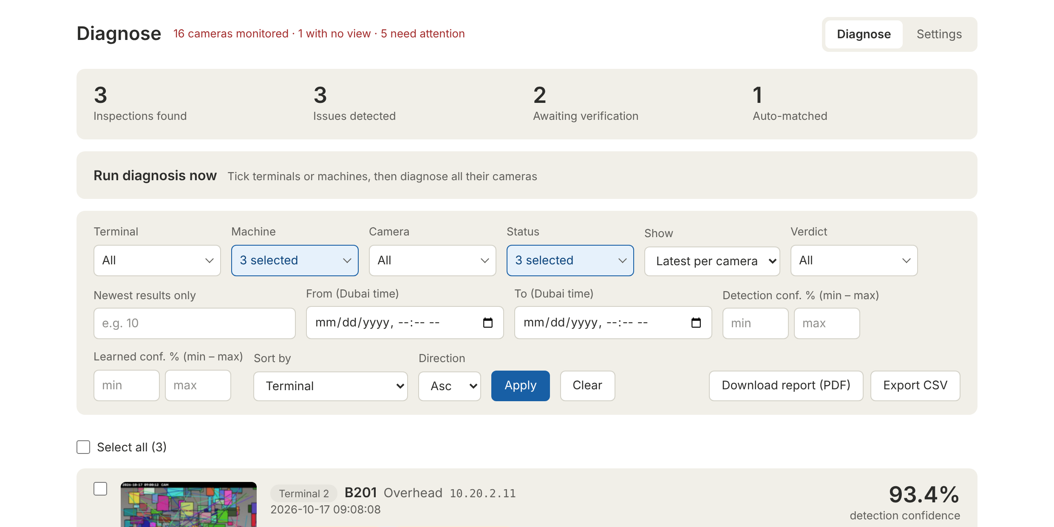
Getting started
Start once, keep it running, open it from any PC on the network
1 Double-click run.bat on the platform PC
2 Leave the black console window open
3 From any PC: http://<platform-PC>:5070
4 Header shows cameras monitored; red = no view or server unreachable
5 Diagnose tab = results. Settings tab = cameras and schedule
Diagnose tab: live status, summary figures, Run diagnosis now, filters (each can hold several values)
DON'T close the console or let the PC sleep before the run. More than 3 hours late = run skipped until the next scheduled day.
CAMERA HEALTH PLATFORM | TRAINING 9
Notes:
Demonstrate: run.bat on the platform PC, the console window, the browser opening. Then open the dashboard from a trainee's PC using the platform PC's address and port 5070. Point out the header status line and the two tabs.

Slide 10
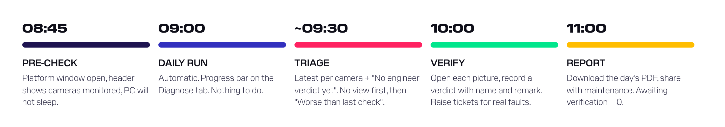
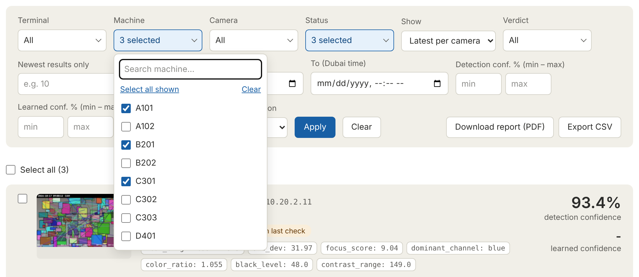
The daily routine
Same steps every day: the backlog ends at zero
TRIAGE FILTER | SET IT TO
Today's to-do list | Show: Latest per camera · Verdict: No engineer verdict yet
Your area only | Terminal / Machine: tick several, e.g. A101 + A102 + B201
Dead cameras first | Status: No view
Then worsening ones | Verdict: Worse than last check
Rest, most obvious first | Sort by: Detection confidence · Desc
Each filter takes several values: tick, then Apply. Nothing ticked = all.
CAMERA HEALTH PLATFORM | TRAINING 10
Notes:
This is the core SOP. Triage order matters: No view first (no picture at all, usually network or maintenance), then Worse than last check (known problems getting worse), then the rest by confidence. NEW: Terminal, Machine, Camera, Status and Verdict filters each take several values - open the list, tick several (the Machine and Camera lists have a search box), press Apply. Ticks inside one filter mean 'any of these'; different filters combine. Nothing ticked = all. Demonstrate: your own machines only, Status No view + Too dark. End of day: Awaiting verification = 0 and the PDF shared.

Slide 11
What the statuses mean
Colour tells you how urgent: green OK, red no picture, amber needs attention
STATUS | TYPICAL CAUSE | FIRST ACTION
OK | Picture looks normal | Nothing
No view | Power, cable, network, wrong IP / port / path / password | Ping · Test capture now · ticket
Too dark | Lights off, IR illuminator failed, night | Check lighting / IR
Overexposed | Sun glare, exposure or iris fault | Check exposure, position
Green / Blue / Red tint | Colour fault, IR-cut filter, coloured object in view | Compare with earlier pictures
Dirty / blurry lens | Dust, salt, condensation, focus, haze, old soft camera | Cleaning ticket or Old camera verdict
Partial occlusion | Cable, bracket, tarpaulin, mud on part of the lens | Remove obstruction
CAMERA HEALTH PLATFORM | TRAINING 11
Notes:
Go through each status with a typical cause and the first action. Emphasise that tint can be caused by a coloured object filling the view, and Dirty / blurry can be an old camera that is always soft. That is where the verdict reasons come in.

Slide 12
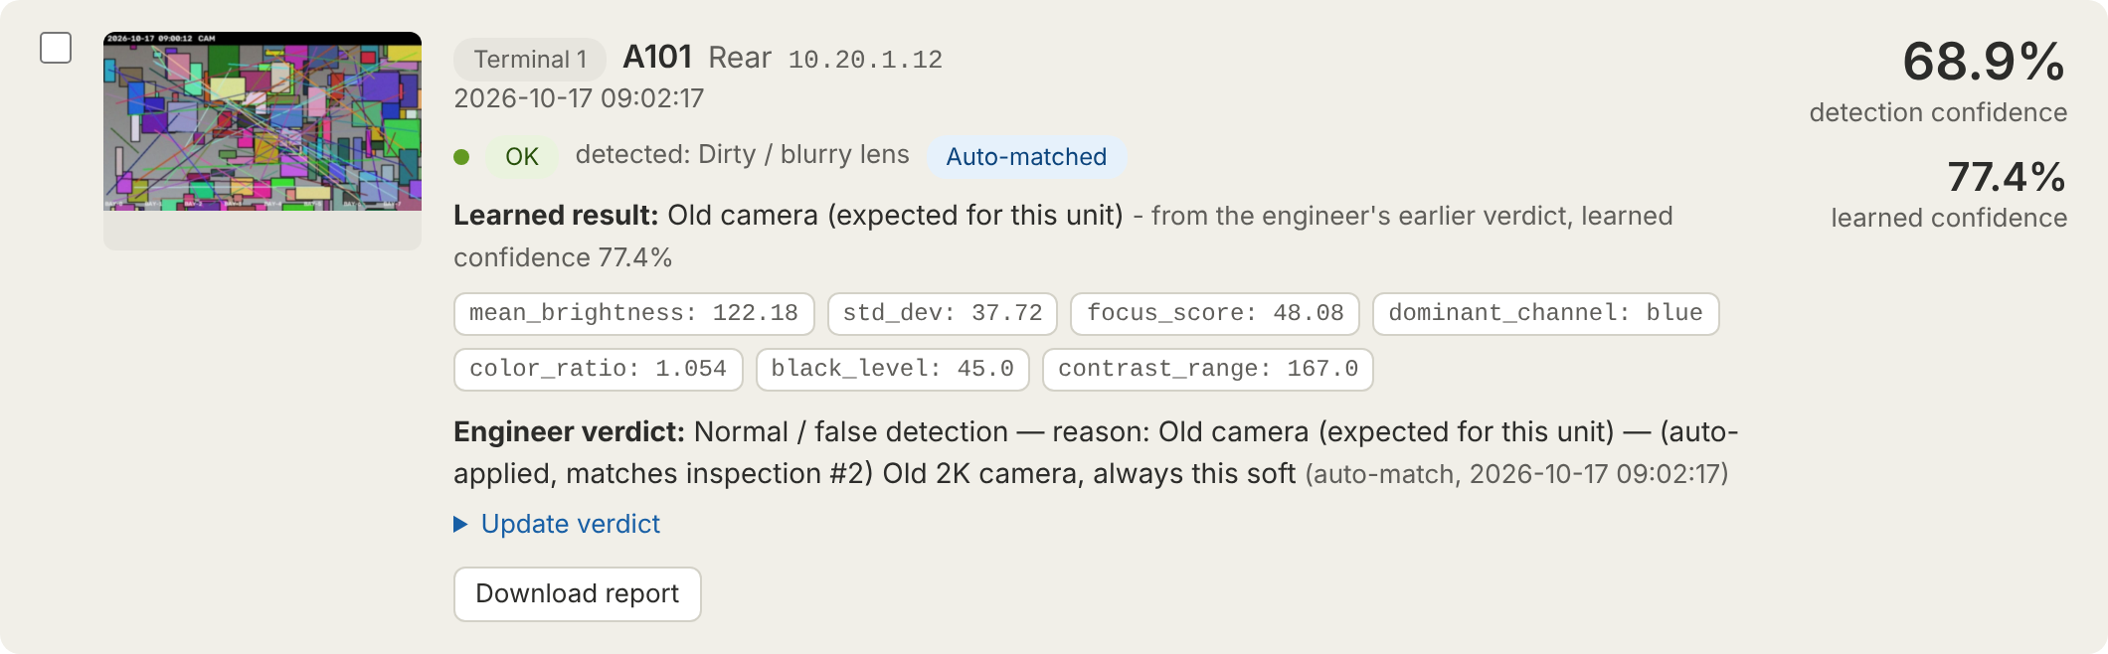
Reading an inspection card
Everything about one picture of one camera
FINAL STATUS + DETECTED
The coloured tag is what is reported. "detected:" shows what the computer found when a verdict changed it.
TAGS
Auto-matched = an engineer's earlier verdict was copied. Worse than last check = look again.
DETECTION CONFIDENCE
50-99.9%. How far past the limit. ~60% borderline, 95%+ obvious. Not a probability.
LEARNED CONFIDENCE
68 → 99%. Trust in an automatic copy; grows with each repeat.
CAMERA HEALTH PLATFORM | TRAINING 12
Notes:
Use the real card: detected Dirty / blurry, but the final status is OK because an engineer marked this unit as an old camera, and the platform copied that verdict (Auto-matched) with 77% learned confidence. Explain the two confidence numbers: detection = how obvious; learned = trust in the copy.

Slide 13
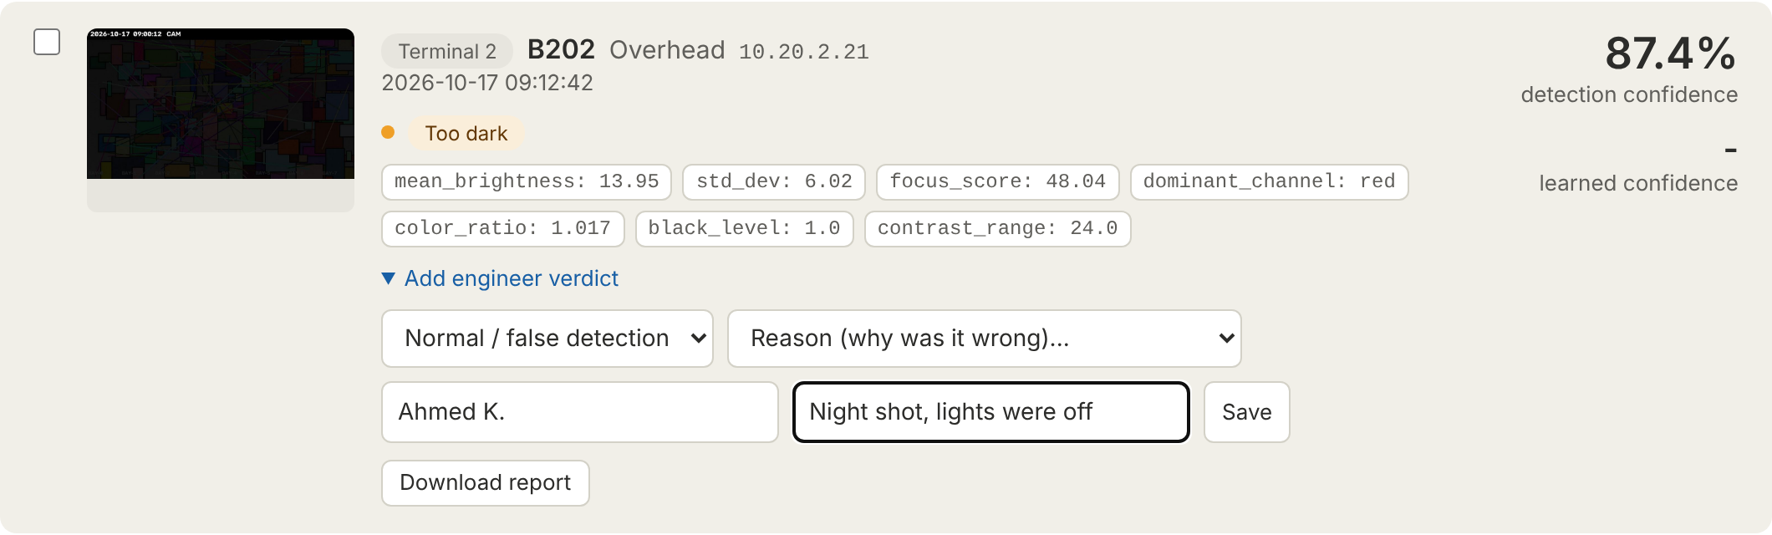
Verifying a result
Your verdict becomes this camera's baseline, so get it right
YOU SEE... | CHOOSE
The problem is real | Same as detected + ticket
Fine; older / lower-quality camera | Normal › Old camera
Fine; scene caused it (colour, night, sun) | Normal › OK
A different real problem | Normal › that problem
Not sure | Test capture now / check on site
Final status: Same as detected keeps the detection. Normal + Old camera or OK → reported as OK. Normal + a real problem → reported as that problem.
Changed your mind? Update verdict and save again; the newest verdict counts.
CAMERA HEALTH PLATFORM | TRAINING 13
Notes:
Demonstrate on a pending card: open Add engineer verdict, choose Normal / false detection, show the second Reason list, type name and remark, Save. The card updates without reloading. Then walk the decision guide. Stress: if unsure, do not guess, take a fresh picture with Test capture now.

Slide 14
How the platform learns
Per camera, from engineers' verdicts, never from its own guesses
NEW PICTURE
Problem detected on camera X
FIND BASELINE
Latest engineer-verified inspection of X with the same detection
SAME OR BETTER?
Copy the verdict → Auto-matched, learned confidence rises
CLEARLY WORSE?
Nothing copied → Worse than last check → a person looks
Learned confidence after each consecutive confirmation of the same result
CAMERA HEALTH PLATFORM | TRAINING 14
Notes:
Explain the baseline: the latest inspection of the same camera with the same detection that an engineer verified. Automatic copies are never baselines, so the reference cannot drift. Same or better → copy. Clearly worse (higher detection confidence than the baseline by more than the margin) → Worse than last check. Then the learned confidence curve: 68, 77, 84, 88, 92 ... 99%.

Slide 15
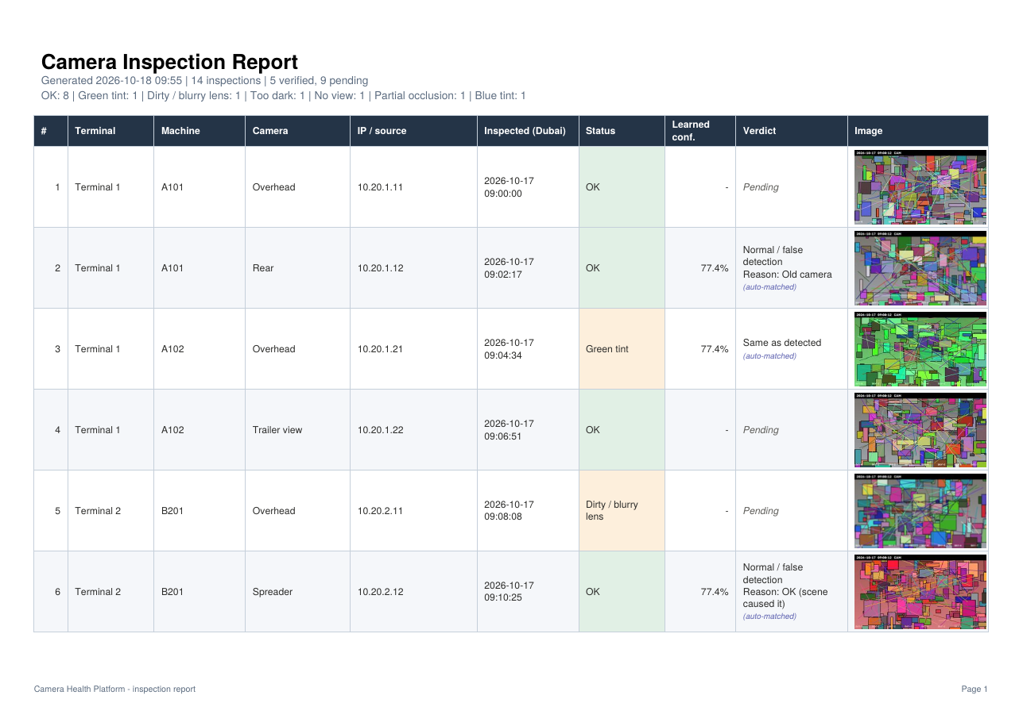
Reports and exports
Any filter, any selection, as PDF with photos or CSV for analysis
YOU WANT | DO THIS
One inspection | Download report on the card
Everything filtered | Download report (PDF) in the filter bar · max 2,000
Hand-picked | Tick cards › Download selected as report
Data in Excel | Export CSV (both statuses, both confidences)
Daily report: clear filters › Show: Latest per camera › Download report (PDF).
All times are Dubai time on screen, in PDF and CSV and in the From / To filters.
CAMERA HEALTH PLATFORM | TRAINING 15
Notes:
Show the four ways: one card, everything filtered (max 2,000 rows), hand-picked selection, CSV. Open a PDF and point out Pending, the small blue auto-matched label and the coloured status cell.

Slide 16
Managing cameras
One at a time, or thousands from Excel
ADD
IMPORT
Settings › Add camera. Required: Terminal, Machine, Camera, IP (add :port if not 554). Pick suggested names so spellings match.
Download template › one camera per row › Import. Skip or update existing. Problem rows are listed by row number; good rows still import.
TEST
DISABLE / DELETE
Test capture now takes a picture immediately. Result appears on the Diagnose tab.
Disable pauses a camera. Delete keeps all history (tagged Removed); same names re-added re-link it.
CAMERA HEALTH PLATFORM | TRAINING 16
Notes:
Add camera: four required fields, port only if not 554, RTSP path default is Hikvision. Import: template, required columns, skip vs update, problem rows listed with row numbers. Delete keeps history; re-adding the same three names re-links it.

Slide 17
The inspection schedule
How often, at what time, and how hard the network is pushed
SETTING | DEFAULT | EFFECT
How often | Every day | Daily · every 2-60 days · weekdays · day 1-28 or last
Start time | 09:00 | PC clock, on every scheduled day
Automatic inspection | On | Off stops the automatic run
Which cameras | All | Untick terminals / machines
Pause between cameras | 2 s | Longer = quieter network
Cameras at the same time | 8 | 1-32; same machine never together
Detections | All on | Untick a check to skip it (not No view)
How often: weekly on chosen days, every N days from a start date, or one day a month
Check: "Saved schedule: the inspection runs ..." and Next run show what will happen. Asleep > 3 h past start = skipped until the next scheduled day.
CAMERA HEALTH PLATFORM | TRAINING 17
Notes:
Show Settings > Schedule. NEW - How often: every day, every N days (2-60, counted from a start date, so it carries on across months), weekly on any ticked weekdays (one day = once a week, two days = twice a week), or monthly on day 1-28 or the last day (29-31 are not offered because some months lack them). The line 'Saved schedule: the inspection runs ...' and Status > Next run show exactly what will happen. The same cameras (Which cameras) and the 3-hour wake-up rule apply to every frequency. Detections: any check except No view can be switched off for ALL cameras and new inspections only. Cameras at the same time: default 8, never two from one machine together.

Slide 18
Hands-on exercises
Work in pairs on the training platform | ~45 minutes
1
MORNING TRIAGE
Build the to-do list (Latest per camera + No engineer verdict yet). How many cameras? Which is No view?
2
VERIFY THREE RESULTS
Give a correct verdict with name and remark to a real fault, an old camera and a scene-caused tint.
3
FIND THE WORSENING CAMERA
Use the Verdict filter to find Worse than last check. Explain why it was not auto-matched.
4
ADD AND TEST A CAMERA
Add a test camera, run Test capture now, then disable and delete it. Where is its history?
5
DAILY REPORT
Produce the PDF for Terminal 2, latest per camera, and a CSV of last week.
CAMERA HEALTH PLATFORM | TRAINING 18
Notes:
Use the training instance loaded with test cameras (testimg: sources). Each pair completes the five exercises; the trainer checks each one off in the training workbook. Answers are in the workbook's Exercises sheet.

Slide 19
Knowledge check
Five questions before sign-off (answers in the speaker notes)
After the run, which two groups do you check first?
1
An old 2K camera is flagged Dirty / blurry every day but looks normal for that unit. Which verdict?
2
A detection confidence of 62% means a 62% chance the camera is faulty. True or false?
3
Why would a camera with a verified dusty lens show Worse than last check instead of Auto-matched?
4
What happens to a camera's history when you delete it in Settings?
5
CAMERA HEALTH PLATFORM | TRAINING 19
Notes:
Answers: 1) No view, then Worse than last check. 2) Normal / false detection, reason Old camera. 3) No: it shows how far past the limit the measurement is. 4) The new picture was clearly worse than the engineer-verified baseline, so the verdict was not copied. 5) Inspections, verdicts and pictures are kept; the camera is tagged Removed and re-adding the same Terminal + Machine + Camera re-links them.

Slide 20
Module C
Administration
IT & administrators | 1 hour
Notes:
Module C summarises the Installation & Administration Guide; hand that out.

Slide 21
Administration essentials
What IT needs to set up and keep healthy
INSTALL
NETWORK
• Python + copy folder + run.bat
• Offline: pip download / --no-index
• PC on Dubai time, never sleeps
• Auto-start (Task Scheduler / service)
• Inbound TCP 5070 from engineering only
• Outbound RTSP TCP 554 to cameras
• /building/status for the dashboard
• Internet only at first install
PROTECT
MAINTAIN
• Add sign-in (reverse proxy)
• waitress instead of Flask dev server
• Secret key from environment
• View-only camera account; folder ACLs
• Back up DB + screenshots weekly
• Retention: archive old picture folders
• Upgrade: replace code, DB auto-migrates
• Quarterly threshold review
CAMERA HEALTH PLATFORM | TRAINING 21
Notes:
Walk the four quadrants. Highlight: the platform PC must be on, awake and on Dubai time; port 5070 inbound only from engineering; RTSP 554 outbound to cameras; backups of the database and screenshots; and the security items before wider use.

Slide 22
Troubleshooting
The six problems you will meet most often
SYMPTOM | LIKELY CAUSE | CHECK / FIX
One camera No view | Camera, cable, IP / port / path / password | Ping · VLC test · Edit · Test capture now
A whole terminal No view | Network at that terminal | Network team · re-run with Run diagnosis now
No results today | Platform stopped, PC slept > 3 h, daily switch off, terminal unticked | Schedule page: Next / Last run, Which cameras
Server unreachable | Platform stopped or PC off | Start run.bat / the service
Same false alarm daily | No verdict given yet | Verdict: Old camera or OK
Captures slow | Helper processes blocked (antivirus) or too few at once | Console messages; raise Cameras at the same time carefully
CAMERA HEALTH PLATFORM | TRAINING 22
Notes:
For each row ask the room for the likely cause before revealing the check.

Slide 23
Your training pack
Everything referred to today
USER MANUAL
QUICK REFERENCE CARD
EXECUTIVE OVERVIEW
Word · engineers
PDF · desk
PDF · management
Every screen, the daily routine, verification, reports, FAQ
Two printable pages
Value, readiness, rollout
TECHNICAL GUIDE
INSTALL & ADMIN GUIDE
TRAINING WORKBOOK
Word · developers / IT
PDF · IT
Excel · trainers
Architecture, algorithms, data, tuning, review findings
Install, secure, back up, upgrade
Plan, sign-off, exercises, import template
CAMERA HEALTH PLATFORM | TRAINING 23
Notes:
Point people to the right document for their role. The workbook includes the competency checklist each engineer completes with their supervisor in the first week.

Slide 24
Notes:
Thank everyone; collect the knowledge-check answers and schedule the on-the-job sign-off.

